Slide 1
BAE Systems Ship Repair
STEM Careers Webinar
March 31st, 2022
Notes:
Image – The first double drydocking of two Navy Destroyers (DDG Class) in the Titan Drydock – Norfolk VA.
January 28th 2012
USS Bulkeley (DDG 84)
USS Mason (DDG 87)

Slide 2
Agenda
Who’s talking?
What do we do?
Where is it done?
Who does it?
STEM’s Role

Slide 3
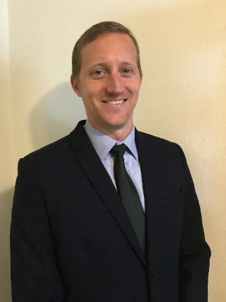
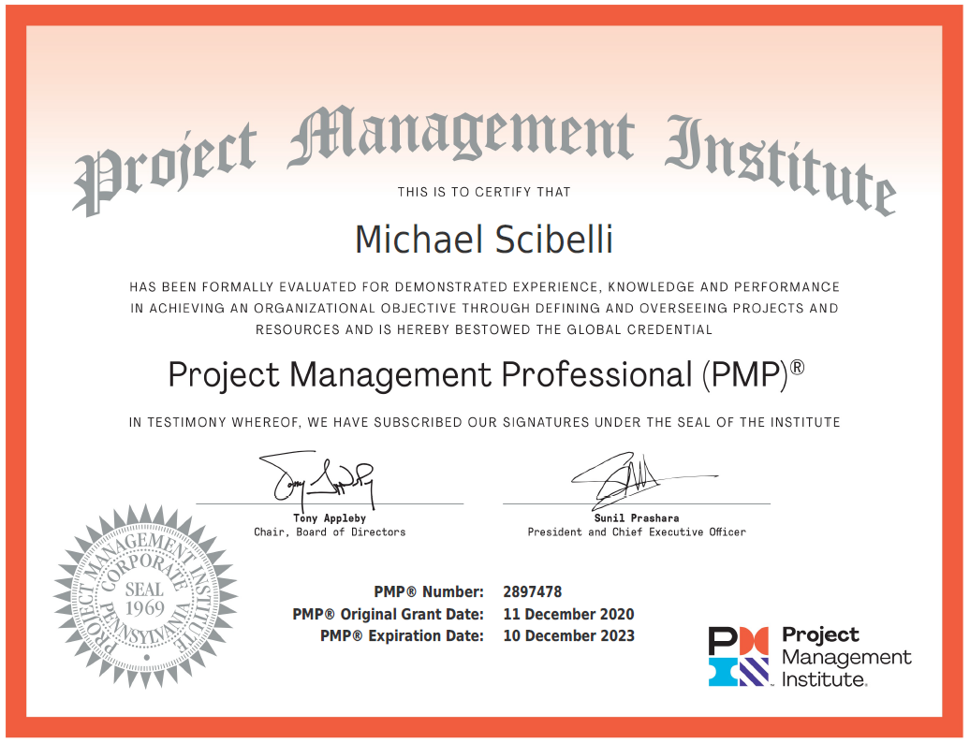
Mike Scibelli Program Manager
Education + Certification
June 2007 – July 2014
New Construction Carrier
Ford Class
Mechanical, Project Engineer
Principle Engineer 2014 - 2018
Manager – Strategic Operations
2018 – 2021
BD, OE, USS Wasp, USS Tortuga
Program Manager – Sept 2021

Slide 4
What We Do
We fix ships – U.S. Navy non-nuclear surface combatants
‘Single’ Customer – Many Voices
LPTA FFP Discretely Awarded Ship Availabilities
Volatile/Unpredictable Business Environment
Competition is King
Primary Competition:
GD NASSCO – Norfolk, Jacksonville and San Diego
Titan Holdings
MHI – Norfolk
Continental Maritime – San Diego
Our competitors are not big defense aerospace companies
Primary Discriminators:
Dry docks – 2:1 in San Diego and Norfolk, only dry dock in Jacksonville
Capitally intensive
Skilled and Experienced workforce
Notes:
MROC – Maintenance, Repair, Overhaul, Conversion
Overhaul and Conversion – Could be minor adjustments to major configuration changes and installation of brand new technology into legacy platforms
Redesignating spaces for new purposes (Marksmanship Training simulator, Joint Strike Fighter)
Orders and Sales ~ $1B+/year
50% to 60% of the Addressable Market
LPTA – Low Price Technically Adequate
FFP – Firm Fixed Price
Big Defense Aerospace Companies – Boeing, Lockheed Martin, Thales, Leonardo, Northrop Grumman
Image – USS San Antonio - generator rotor removal/installation

Slide 5
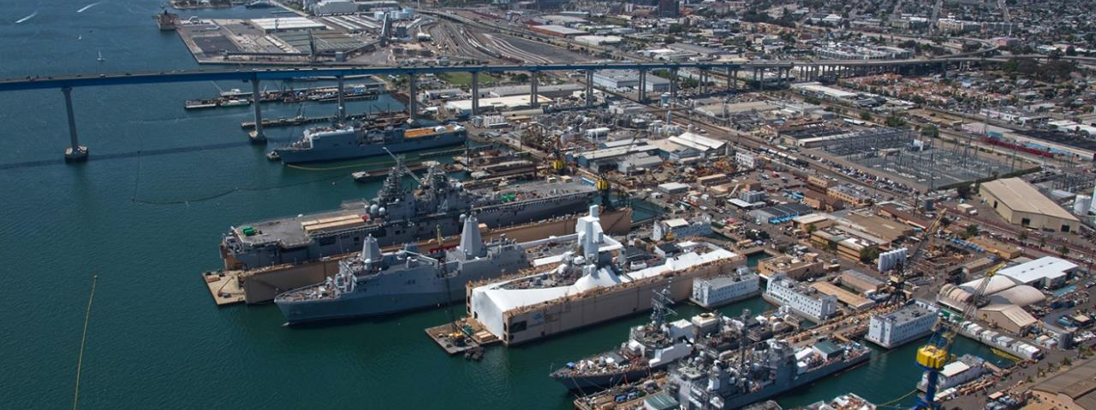
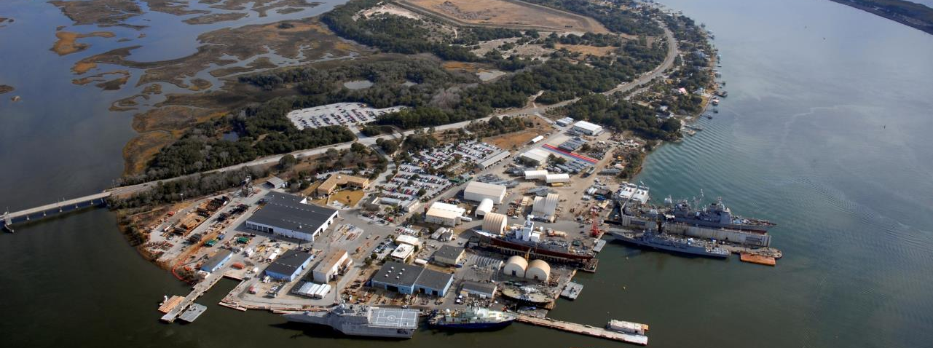
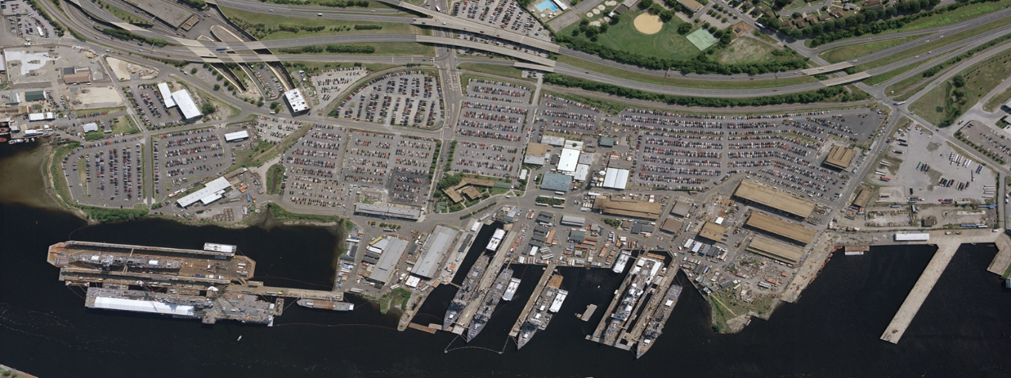
Where we do it
7
Three Shipyards
3,040 Employees
Norfolk 1,215
Jacksonville 620
San Diego 1,205
San Diego, CA
Norfolk, VA
Jacksonville, FL
Five Dry Docks, Two Marine Railways and more than 17,000 feet of Pier Space

Slide 6
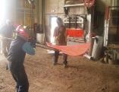
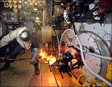
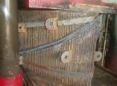
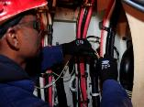
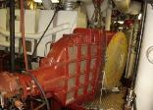
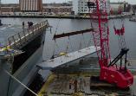
Who does it
Skilled Trades:
Inside/Outside Machine Shops
Rigging and Crane
Sheet Metal
Structural/Plate Fitters
Pipe Fitting
Boiler
Blacksmith
Electrical
Welding
Carpentry
Functional Roles:
Mechanical/Welding Engineering
Financial Analyst
Contract Administrators
Superintendents
Project/Program Managers
Material Planners
Quality Inspectors
Planners/Schedulers
Safety Inspectors
Procurement Analyst

Slide 7
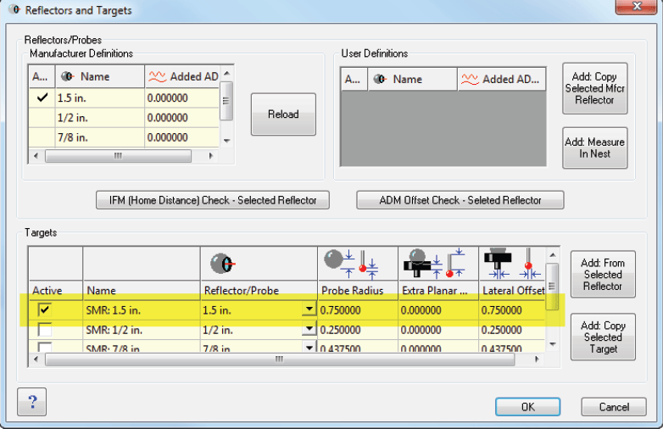
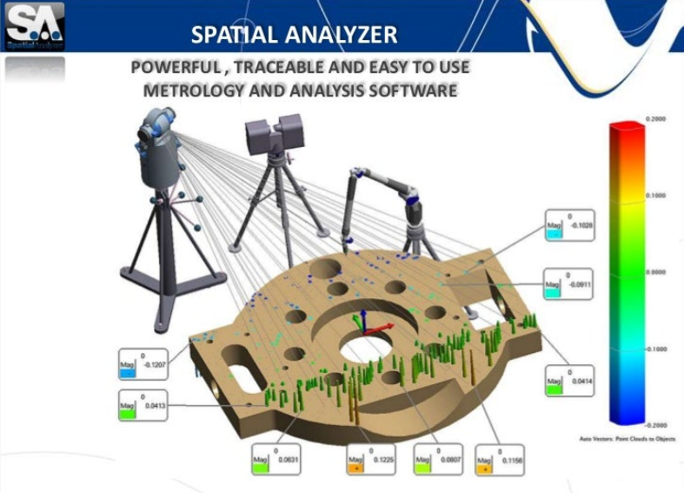
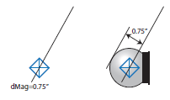
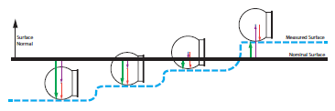
STEM’s Role – Engineering
Notes:
Multivariable Calculus
Matrix Algebra
Differential Equations
Linear Algebra

Slide 8
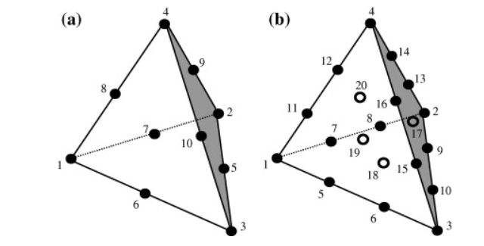
STEM’s Role – Engineering
I WISH I KNEW MORE MATH!!!
Notes:
Multivariable Calculus
Matrix Algebra
Differential Equations
Linear Algebra

Slide 9
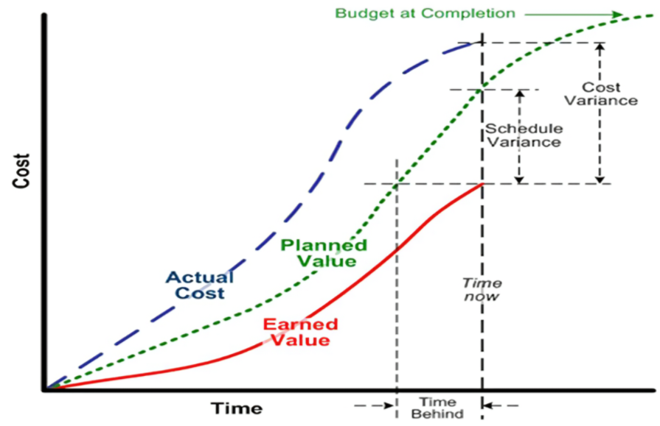
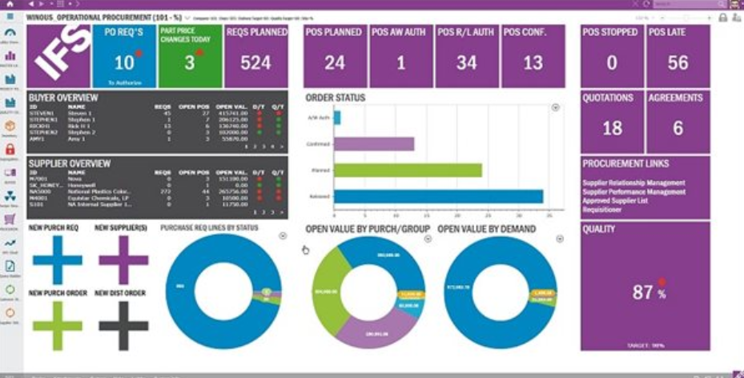
STEM’s Role – Program Management

